Slide 1
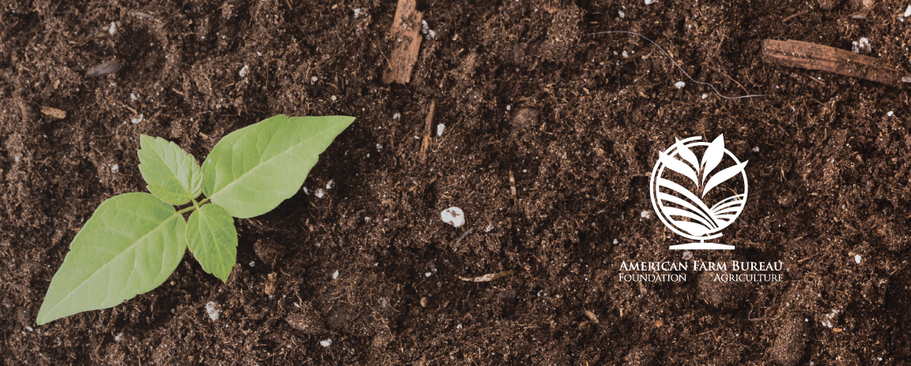
The Necessity of Food
Lesson 5 - Sustainable Agriculture: Social

Slide 2
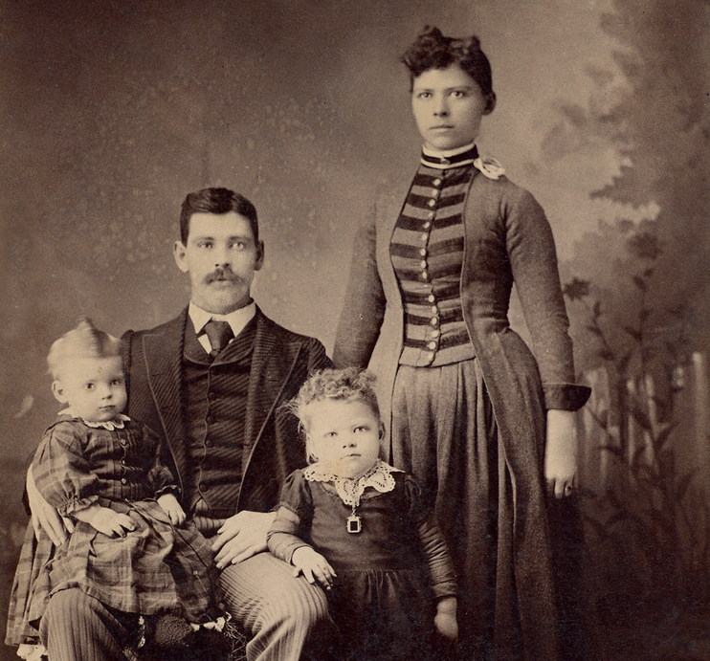
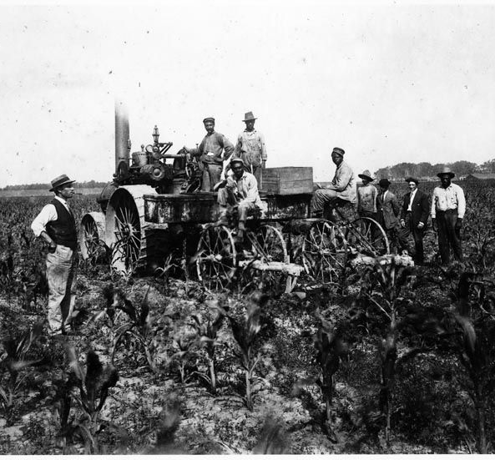
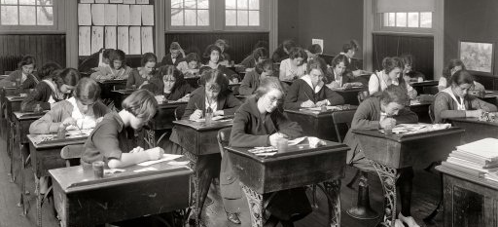
100 Years Ago…
How would you feed your family?
How would you spend your day?
What would you not have time to do?
How would life look different?

Slide 3
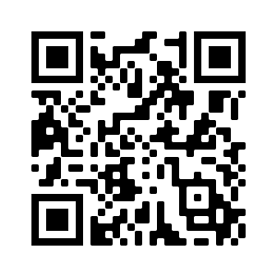
Small Group Jobs
Researcher – gather research on the food product origin. This will include conducting research on how the food product is grown or raised and may include interviewing a farmer or rancher that raises this product.
Researcher – work with the other two researchers to study the transportation options and routes for the food product.
Map maker – work with all researchers to create a visual representation of the route for the food product from the farm to the school community (paper or computer based)
Researcher – study food access in the local community around the school. Research can include Feeding America’s Map the Meal website for community statistics around food.
http://map.feedingamerica.org/

Slide 4
LEARN
What have you learned?

